Slide 1
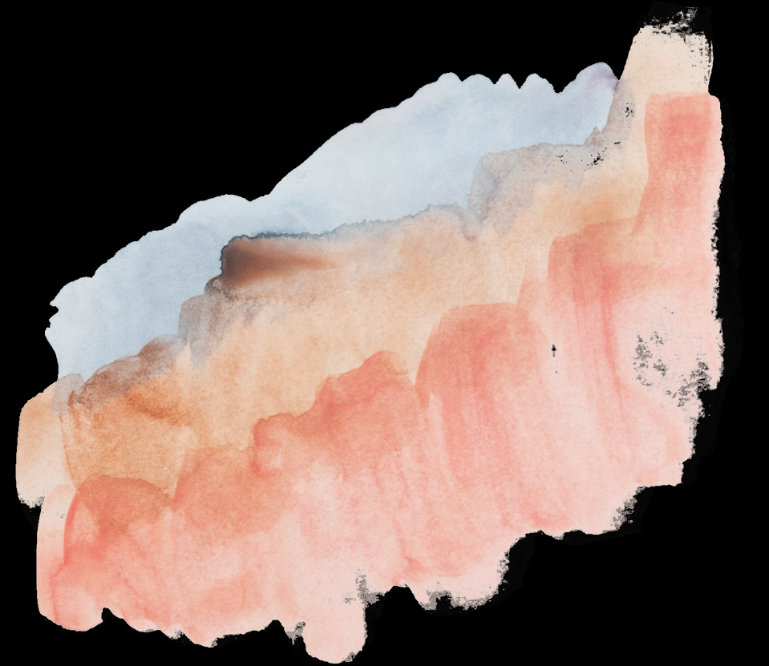
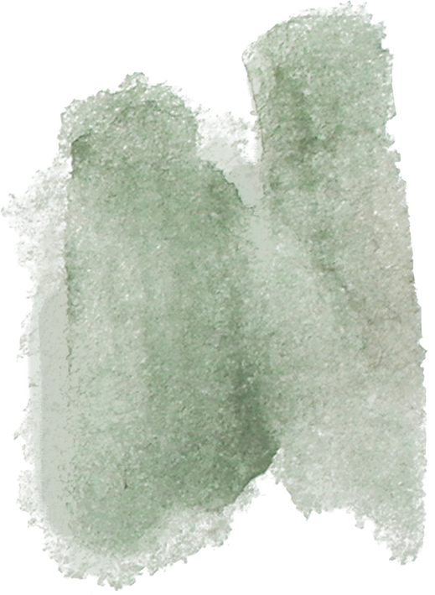
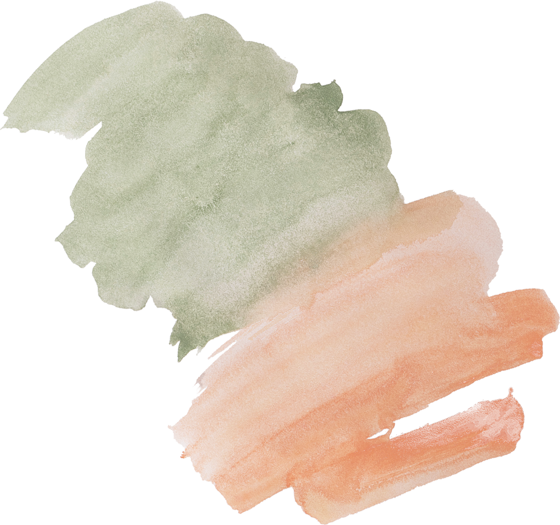




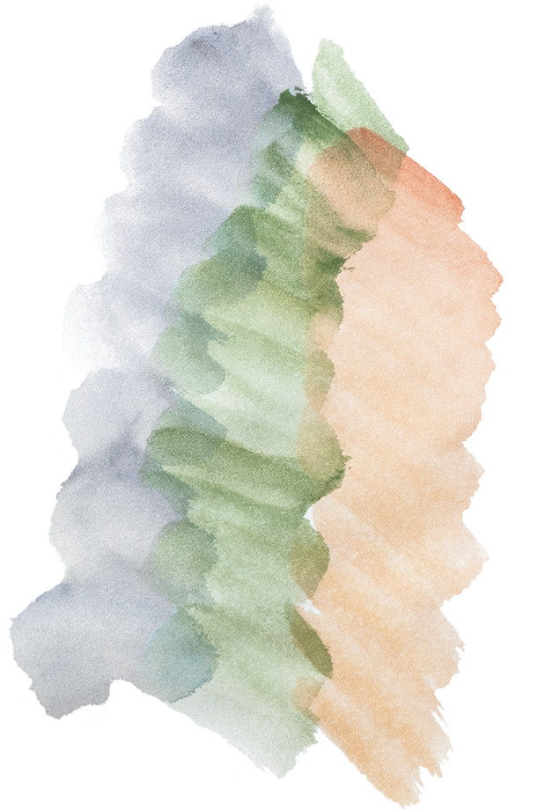
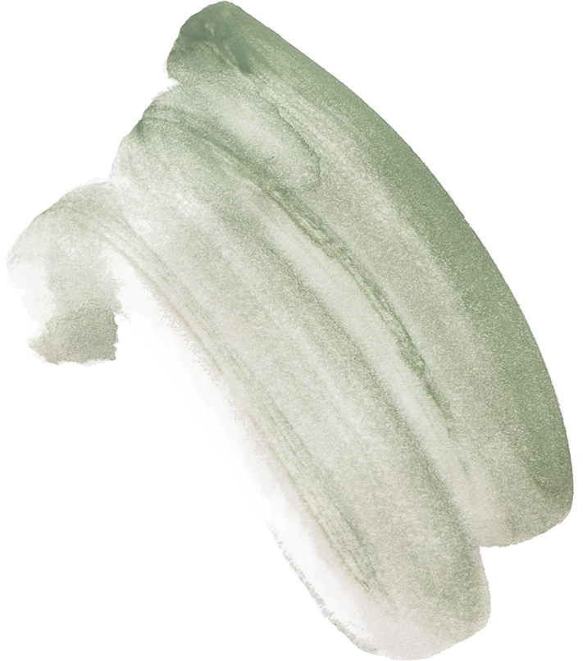
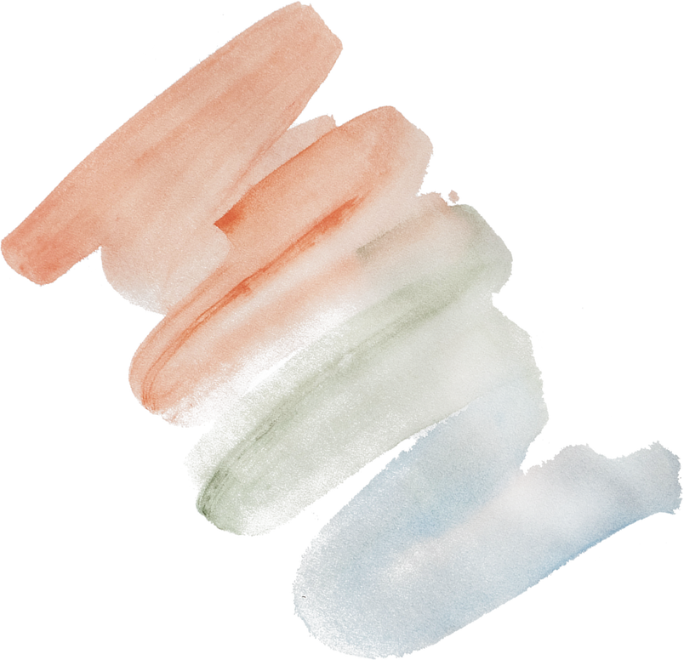
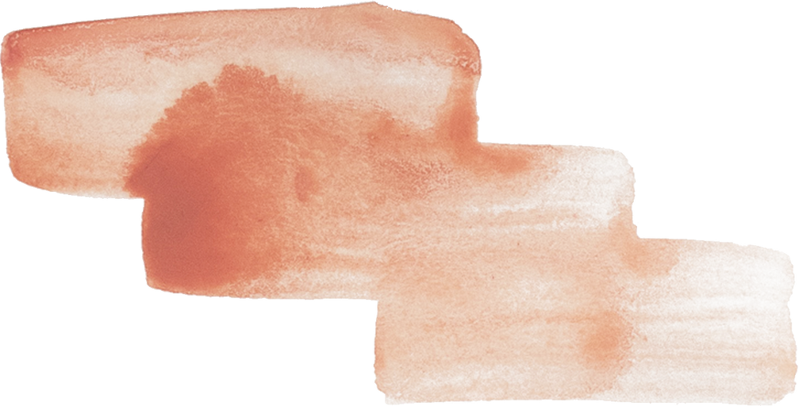
PROJECT PRESENTATION
SUBMITTED TO:
DR. ARUN PUNDIR
SUBMITTED BY:
VISHNU BATRA 102103223
CHARUL WADHWA 102103210

Slide 2
Yoga Posture Detection System
The Yoga Posture Detection System (YPDS) is a groundbreaking technology project that combines computer vision and machine learning to enhance yoga practice. It employs deep learning algorithms to analyze real-time video of practitioners, offering instant feedback on posture alignment, customized to individual needs. With a user-friendly interface, it benefits both practitioners and instructors by deepening practice, reducing injury risks, and providing objective teaching guidance. This innovative fusion of yoga and technology promotes well-being and wider adoption of yoga in the modern era.

Slide 3
Basic Techniques Used
TensorFlow:-TensorFlow is an open source machine learning framework developed by Google, widely used for many machine learning and deep learning tasks.. It is known for its flexibility and scalability.. TensorFlow is designed to work efficiently with large datasets and complex neural network architectures
01.
PoseNet:-PoseNet is a computer vision technique used to estimate the pose (position and orientation) of a person or object in an image or video.It is especially popular in applications such as human pose estimation, augmented reality, and robotics.
02.
Convolutional Neural Network:- Convolutional neural networks (CNN) are a class of deep learning models specifically designed to process structured grid data, such as images and videos.They have revolutionized the field of computer vision and are widely used for a variety of tasks including image classification, object detection, image segmentation, and more.
03.

Slide 4

React for Frontend:-React, often referred to as React.js or ReactJS, is an open-source JavaScript library for building user interfaces. It was developed and is maintained by Facebook (now Meta Platforms, Inc.), and it is widely used for creating web and mobile applications.
04.
Data Preprocessing:- An essential phase in the pipeline for data analysis and machine learning is data pretreatment. It entails preparing raw data for analysis or model training by cleaning, converting, and arranging it.
05.

Slide 5

Libraries Used
TensorFlow: A machine learning framework available as open source software that Google created for creating and refining deep learning models.
Sklearn: A well-known Python machine learning toolkit that offers a variety of modeling and data analysis techniques, such as clustering, regression, and classification.
pandas: A Python data analysis and manipulation package that offers functions and data structures for handling structured data, such as tables.
Numpy: Large, multidimensional arrays and matrices, as well as mathematical methods to work on them, are supported by NumPy, a core library for numerical computations in Python.
CSV: A popular file format for storing tabular data as plain text with values separated by commas is called CSV, or Comma-Separated Values.
wget: A command-line tool for internet file downloads, frequently used for content.
tqdm: A Python package that makes it easy to track the completion of time-consuming calculations or processes by adding progress bars to loops and iterables.

Slide 6

Project Progress
Till Now work done is-
FrontEnd Creation in HTML
(to be converted to React yet)
Dataset Gathering
Data Preprocessing
Model Training

Slide 7
PROJECT TIMELINE
01
02
03
04
Dataset Gathering
Data Preprocessing & Model Training
FrontEnd Creation
Integrating ML Model and Frontend

Slide 8



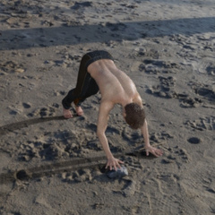
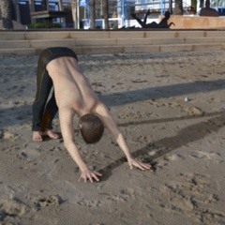

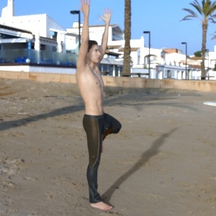
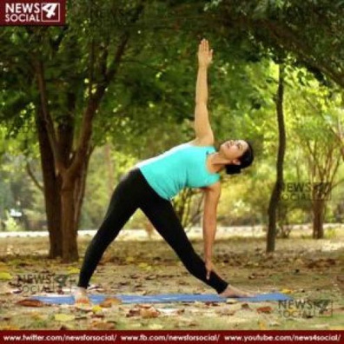
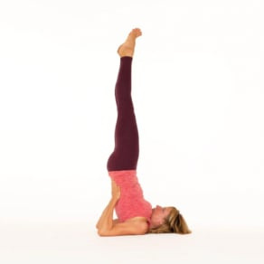

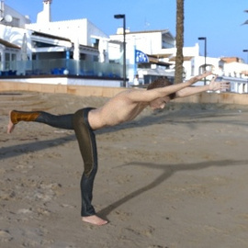
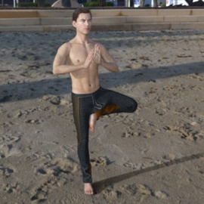
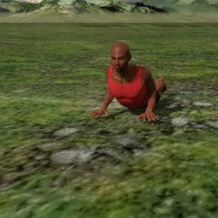

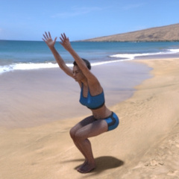
DataSet

Slide 9


Team Members
VISHNU BATRA
102103223
3CO8
CHARUL WADHWA
102103210
3CO8

Slide 10
THANK YOU!

